Slide 1

Project management with GitHub
Safia Safa-tahar-henni
safia.safa-tahar-henni@umontreal.ca

Slide 2
Purpose of this course
It is important for you or your team to keep track of the work to be done on your project. We're going to show you a way to do this with the GitHub Project Board.
It is not the only way to do it, but we want to show you a practical way to do it.

Slide 3
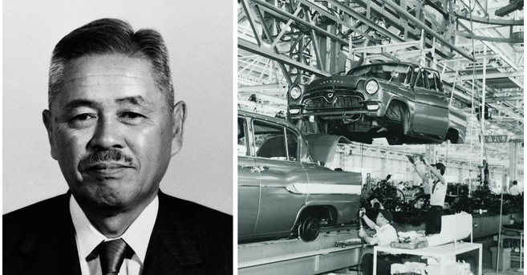
Kanban Method
Taiichi Ōno
Toyota
In the 50's Toyota wanted to compete with its American competitors. To achieve this, the Japanese company called an engineer Taiichi Ōno whose mission was to optimize the construction of the car manufacturer. The latter invented the Kanban method.

Slide 4
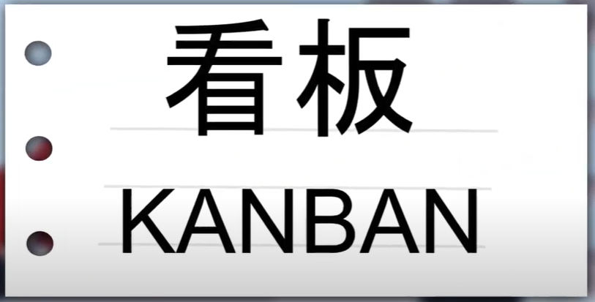

Kanban Method
Coming from the Japanese automobile industry, Kanban aims at continuous process improvement. Companies are now massively using this agile method and its table visualization mode for their project management.
Kanban is a Japanese word meaning tags.

Slide 5
How does the Kanban method work?
To DO | In Progress | Done
Tag
Each represents a task
Kanban card
This makes it easy to manage priorities and to know the progress status of each task that can be easily prioritized.

Slide 6
How does the Kanban method work?
Backlog | To DO | In Progress | Done
Sometimes the tables contain a 4th column, on the left, called the backlog. These are tasks that we are not working on yet.

Slide 7
Example Kanban method
Backlog | To DO | In Progress | Done
ML
Statistical analysis
Parse data
Find dataset
Clustering
Visualization
Find problematic
You can see at a glance what remains to be done, what is in progress and what has already been done.
The Kanban method evolves a project every day with a continuous improvement process.

Slide 8
Example Kanban method
Backlog | To DO | In Progress | Test | Done
ML
Statistical analysis
Parse data
Test parse function
Find dataset
Clustering
Visualization
Find problematic
Note that in some Kanban tables, a Test column can be added before the done column. This is particularly done in development projects that require a feature to be tested before it is considered done.

Slide 9
Introduction to GitHub Project Boards
Github project boards are a feature of GitHub made up of columns that you can use in conjunction with:
Issues: a great way to keep track of tasks, enhancements, and bugs for your projects.
Pull requests: let you tell others about changes you've pushed to a branch in a repository on GitHub.
Notes: Notes can be used to collect information such as task reminders.
The elements of a table are represented by cards, one column represents a status. You can drag and drop cards to rearrange them in a column or move them to another column. You can also slightly modify the issues and pull requests by modifying the card on the table.
In a repository, I can have several project boards.

Slide 10
Templates
You can use templates to quickly set up a new project board.
New board will automatically include: columns, cards with tips on how to use project boards.
There are 4 templates available:
Basic Kanban
Automated Kanban
Automated Kanban with review
Bug Triage

Slide 11
Demo

Slide 12
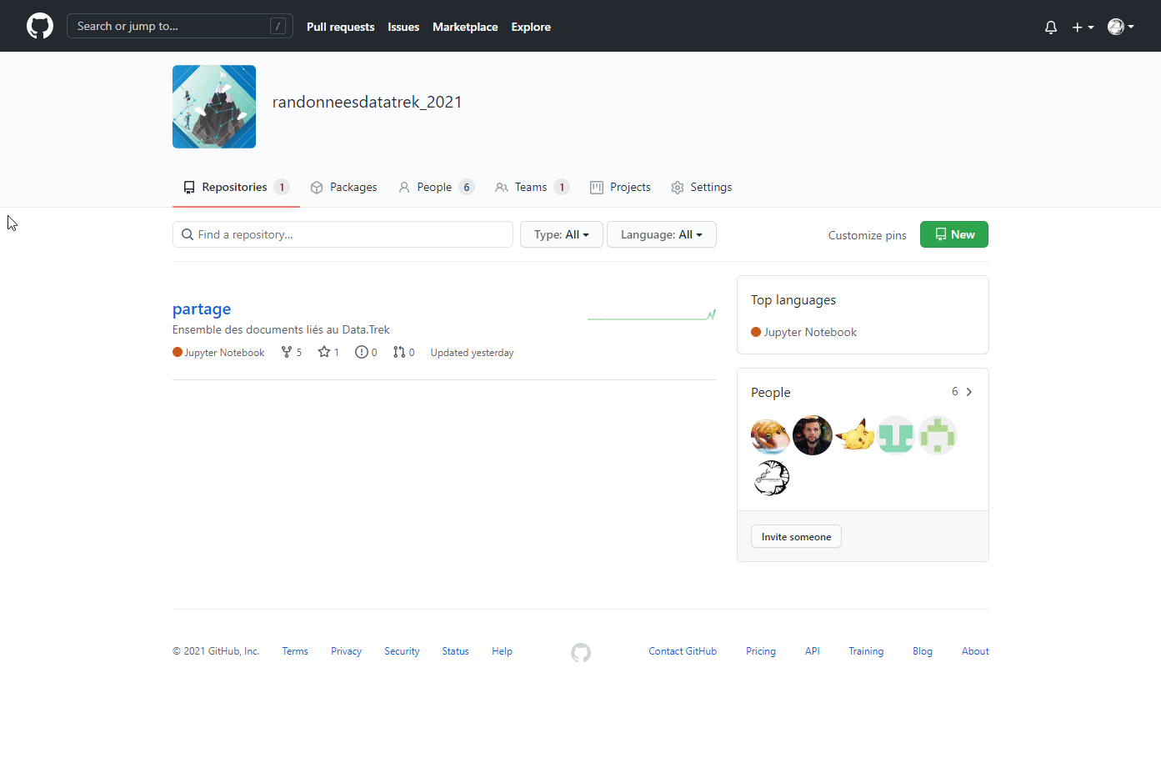
Create a repository

Slide 13
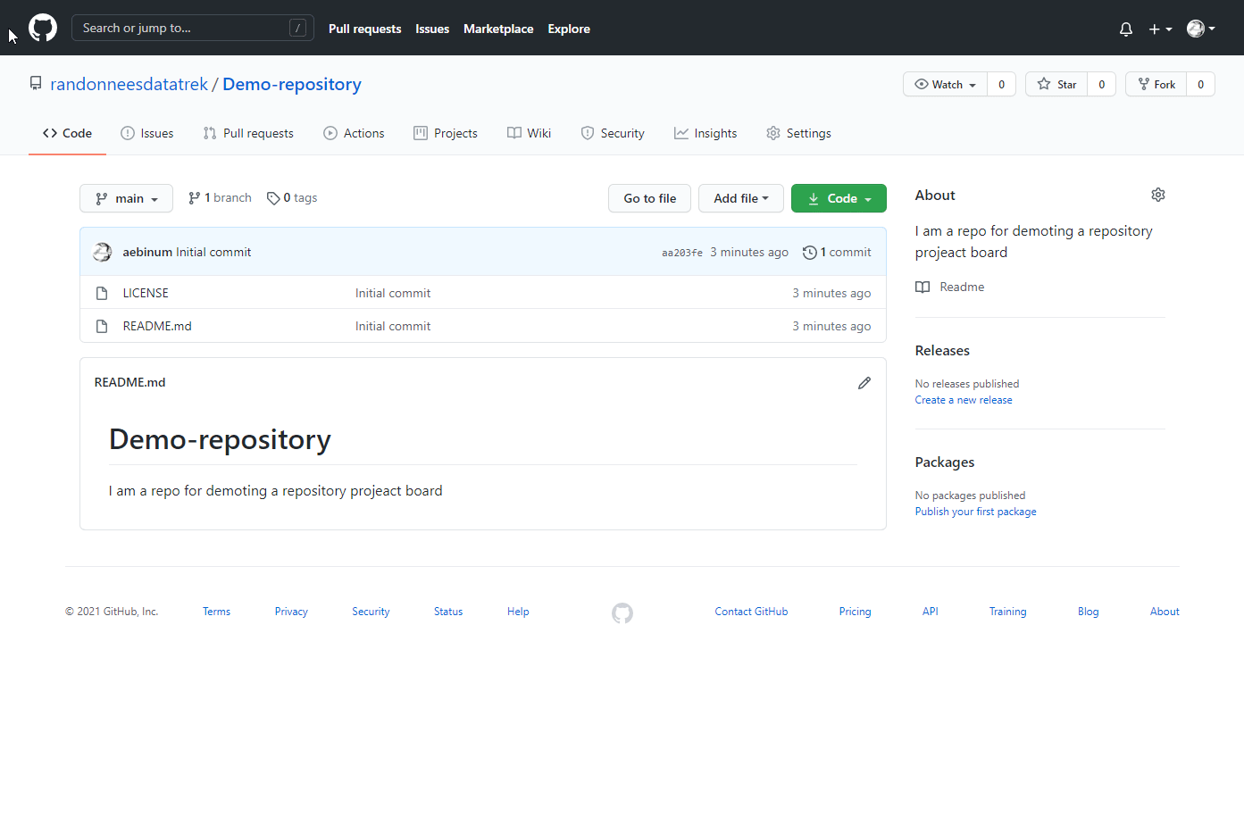
Basic Kanban
With the Basic Kanban, you start with 3 columns: To Do, In Progress and Done. There is no automation by default, you create your cards using issues, pull requests or notes. And you move them manually from column to column following your process.

Slide 14
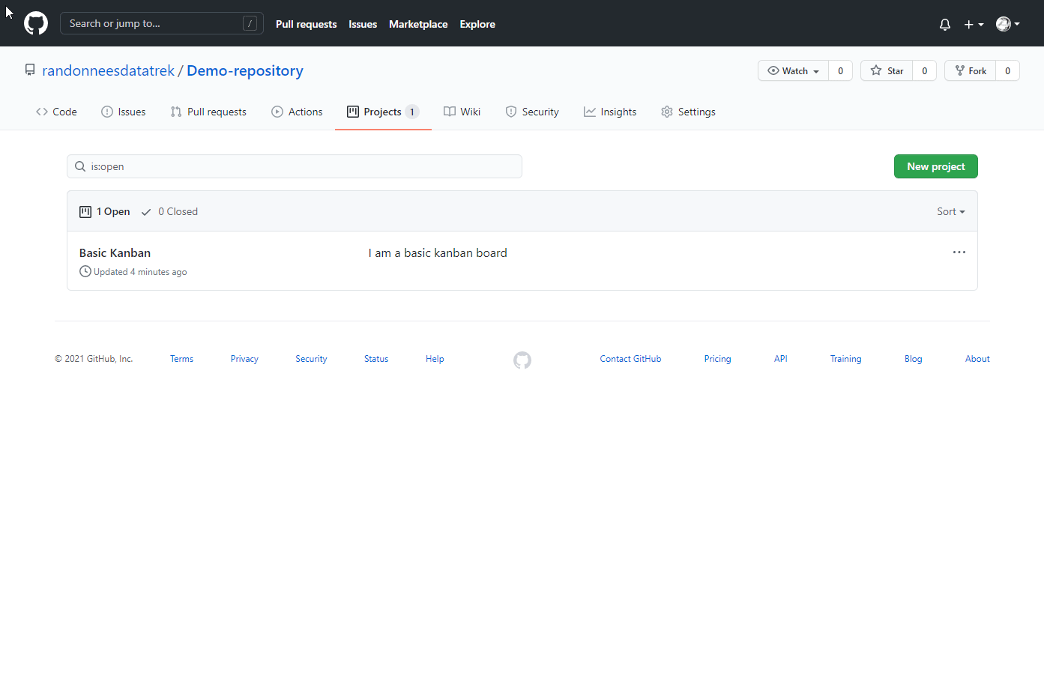
Automated Kanban
With the automated Kanban, the table is exactly the same with the same 3 columns. However, the table is subject to certain automation rules. When certain events occur, such as adding a new issue to the table or closing an issue, the automation starts and automatically moves the card to the appropriate column according to your process.

Slide 15
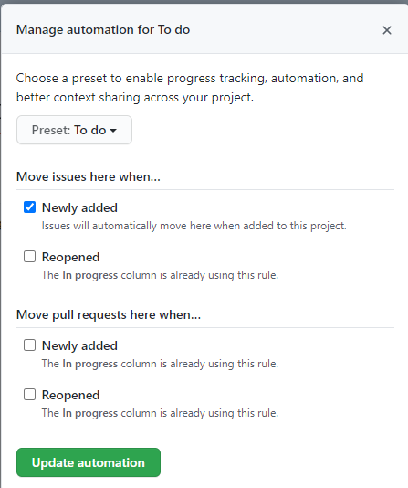
Manage automation
TO DO presets: issues will be automatically moved here when they are added to this project. So when we add a new issue to this project, it will automatically appear in the TO DO column.

Slide 16
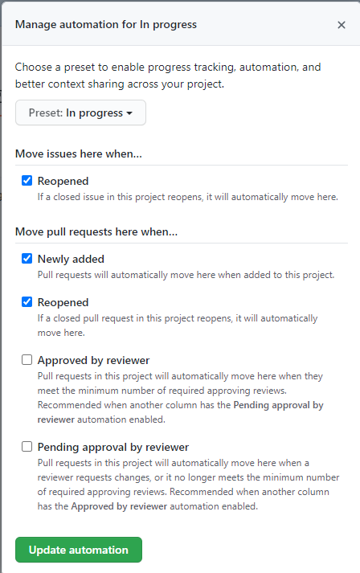
Manage automation
In Progress presets: if an issue is reopened, or if a new pull request is added to the project or reopened it appears here

Slide 17
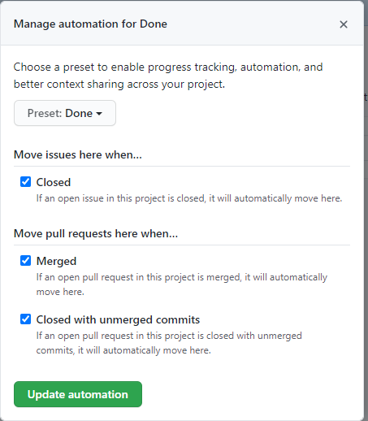
Manage automation
Done presets: if an issue is closed, if a pull request is merged or closed with non-merged commits, it will be moved to this column.

Slide 18
Adding Issues to GitHub Project Boards
What is a GitHub issue?
You can collect user feedback, report software bugs, and organize the tasks you want to accomplish with issues in a directory.
By creating an issue and adding it to a project table, you have the ability to
track and prioritize issues to work on. The issues themselves have no priority or order.
set up a process that will allow you to resolve your issues.
The link between the table and the issue is bi-directional. Updates are reflected in the table and vice versa.

Slide 19
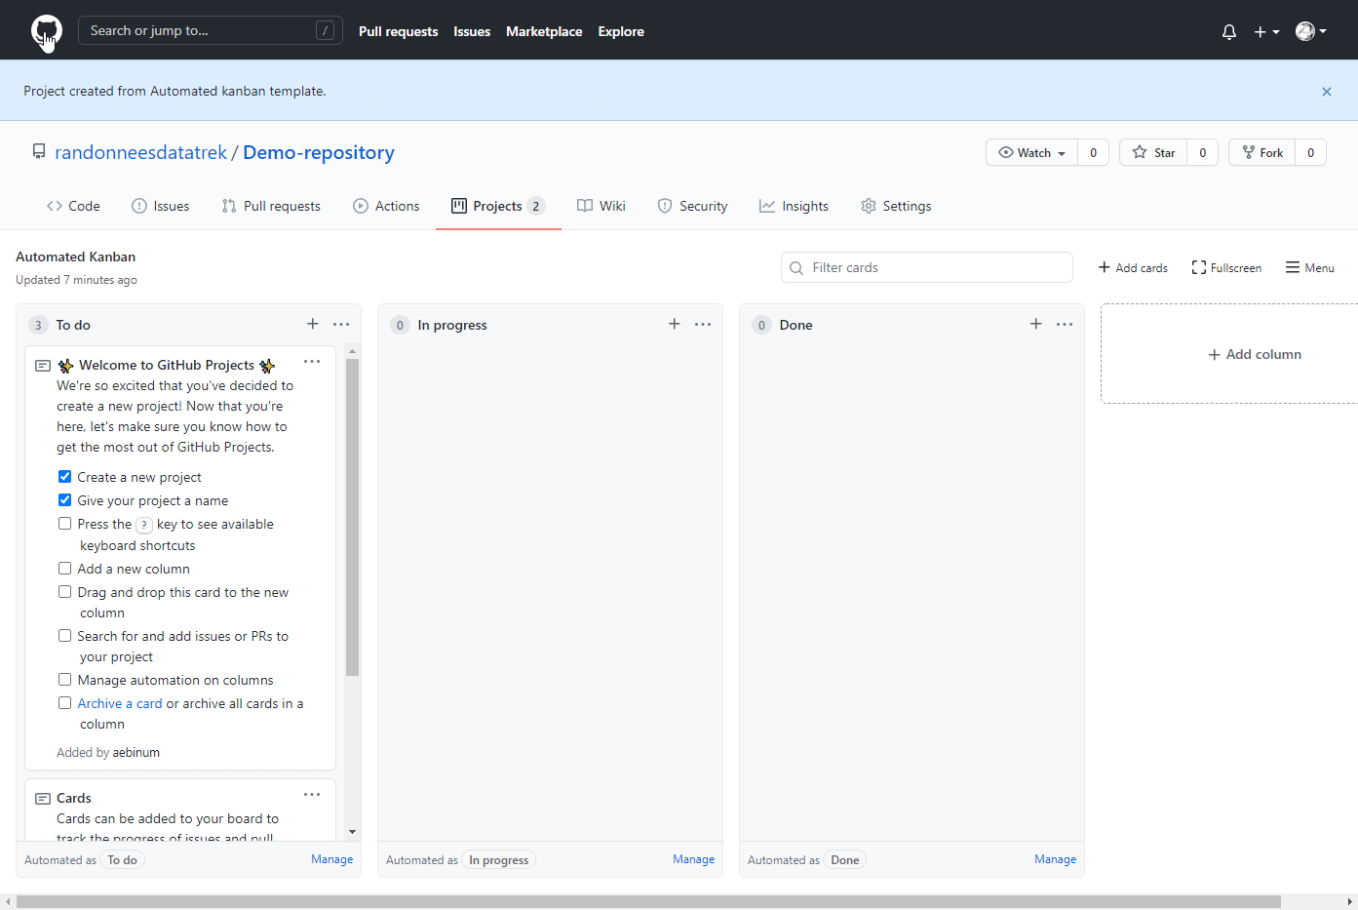
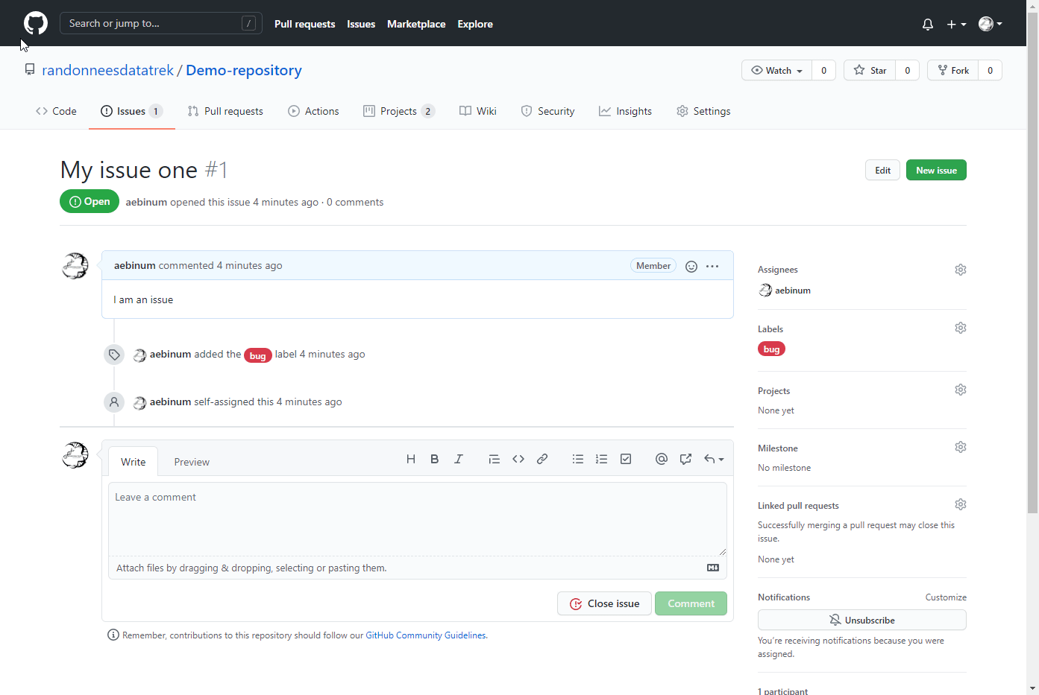
Create issues
Issue 1
Issue 2

Slide 20
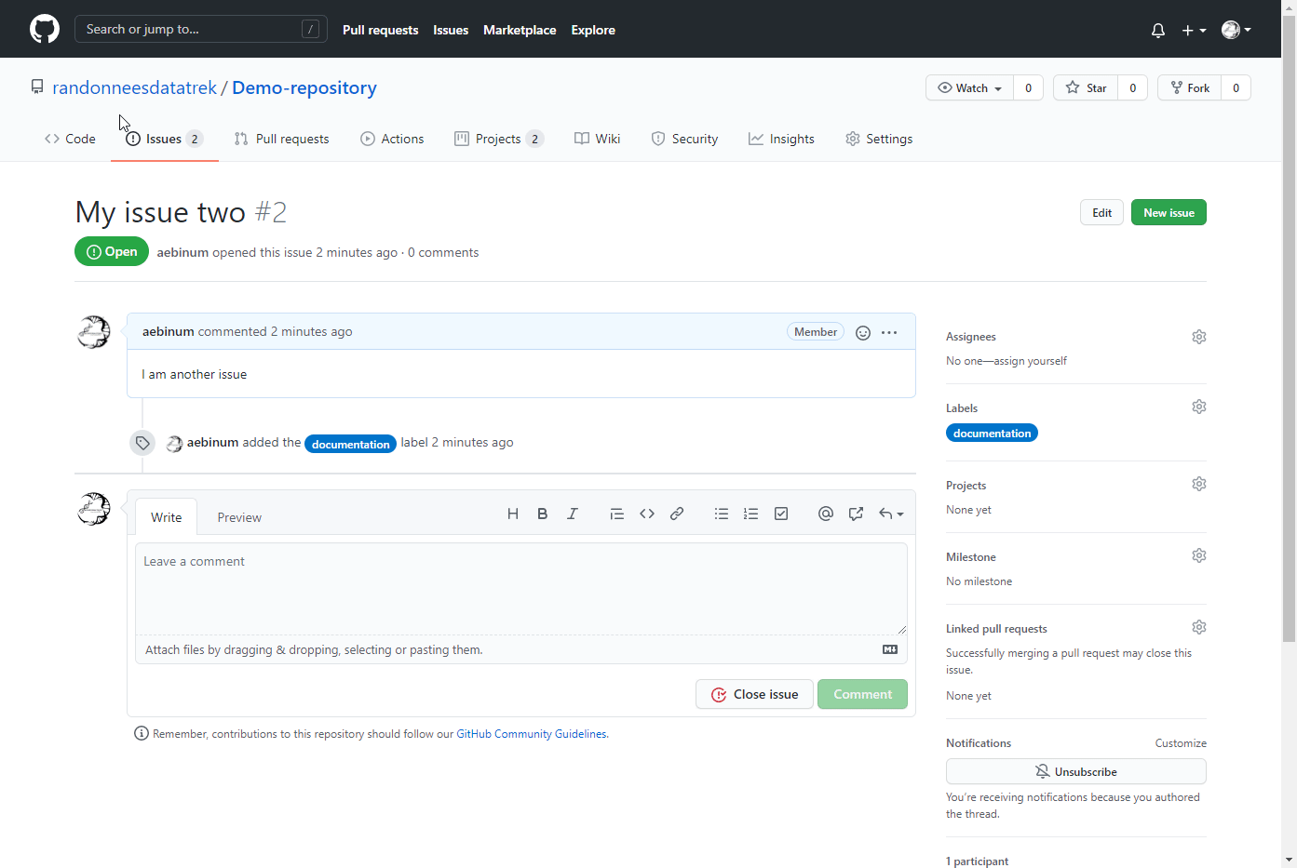
Add issues to a project board
From the Issues page :
If there is no automation: it has not yet been added to a column because it does not know which column to use. In the Project Table tab, the issue is added on the Add cards page in Awaiting sorting mode

Slide 21
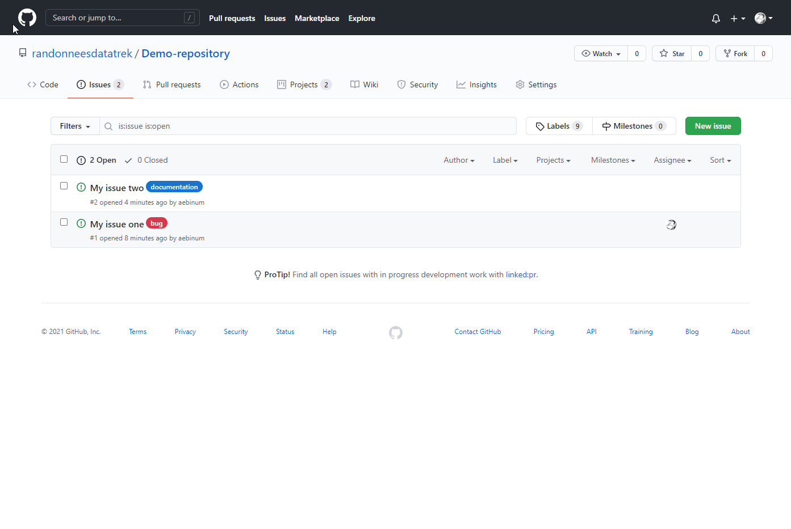
Add issues to a project board
From the Issues page :
If automated: the outcome will automatically go to the TO DO column.

Slide 22
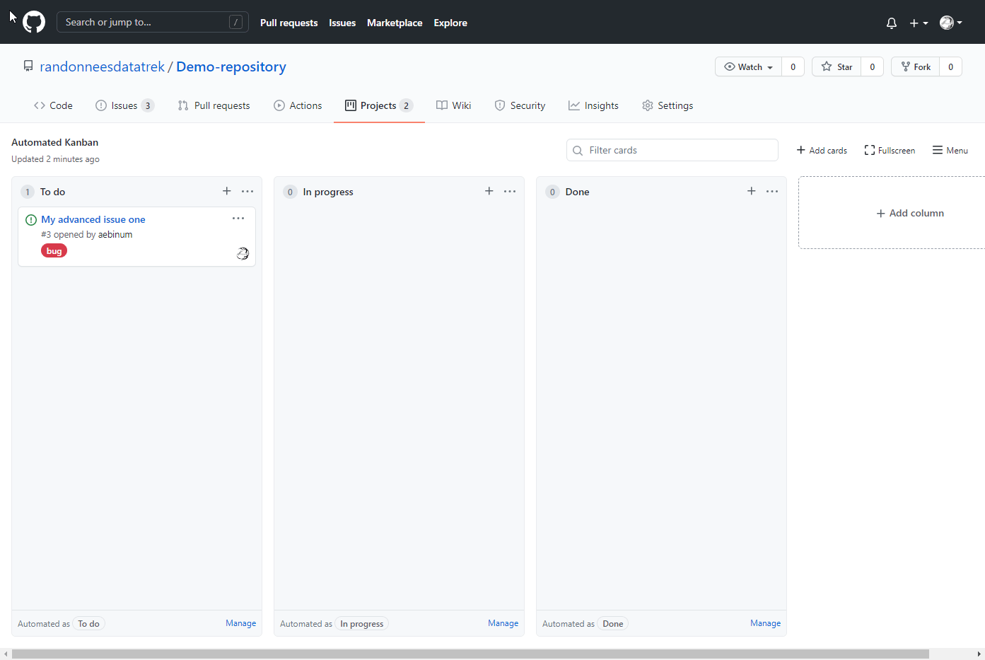
Add issues to a project board
From Project board:
Click Add cards or Menu then +. Then drag the issue to a particular column and place it in the right place. If I don't want it on the board, I can't bring it back.

Slide 23
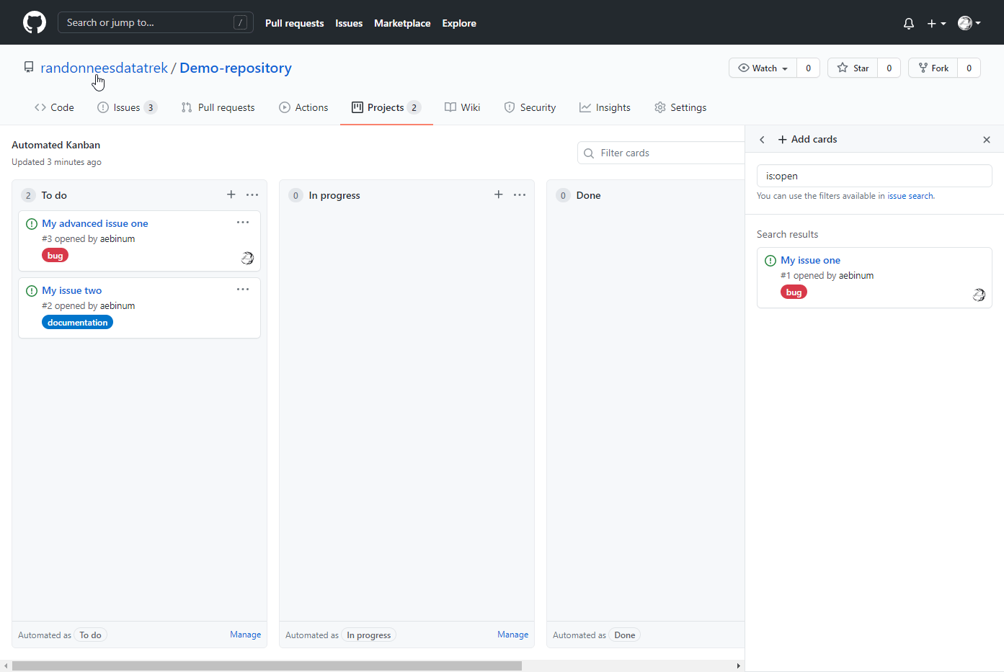
Delete the issue from the project board page
Select the card (...) then remove from project and confirm. The card is then removed from project. If I do a refresh, the card will be back on the page + Add cards.

Slide 24
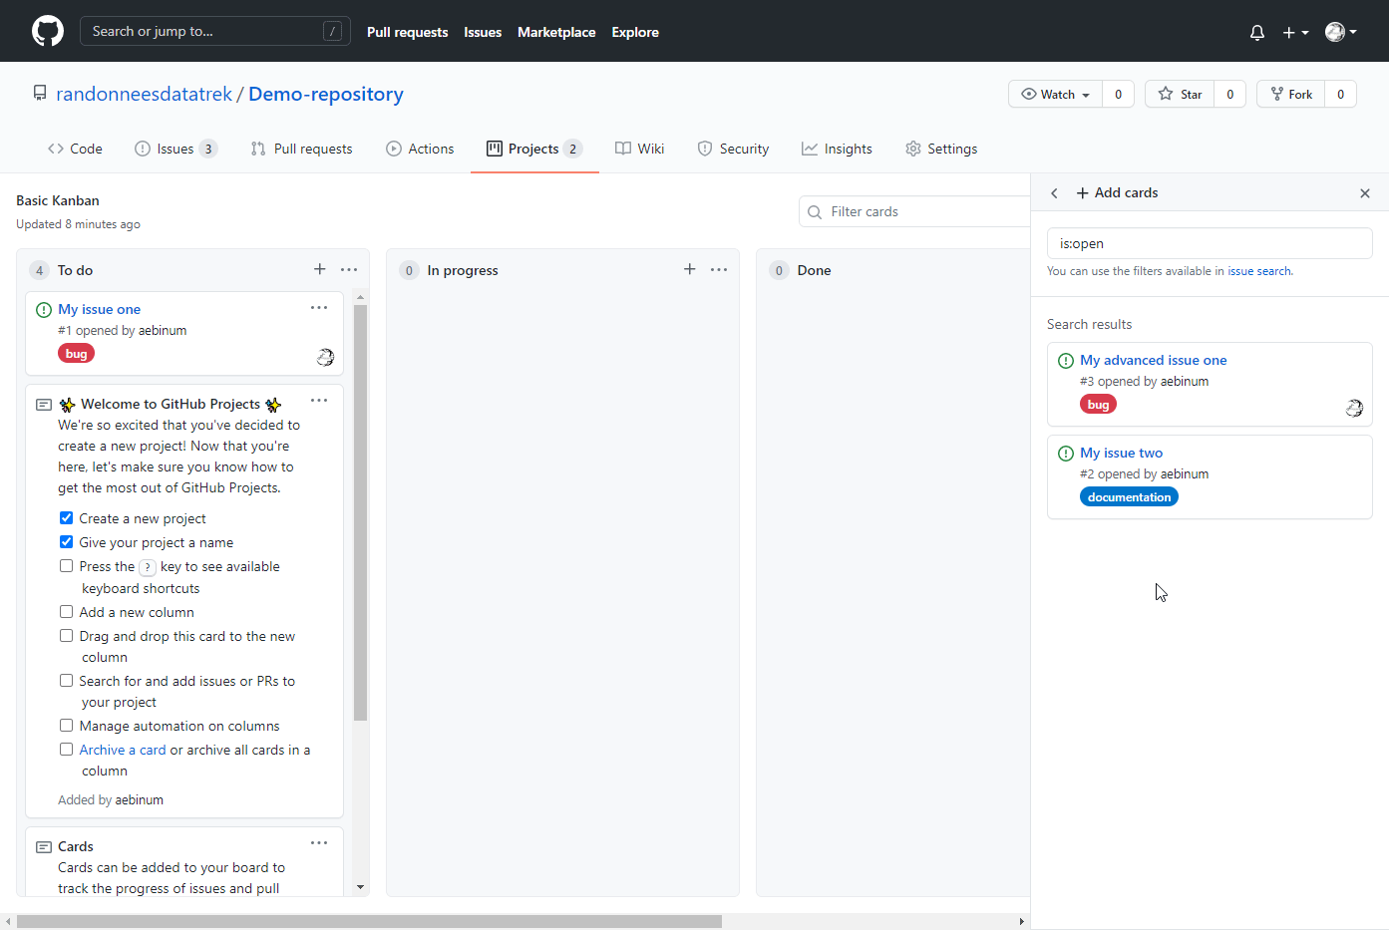
Add a new issue by using keyboard shortcuts
Tab 3 times to move to the first search result then click on the space bar, the card is highlighted and shifted a little, it is now selected. Use the arrow keys to move the card. Press the Enter key to lock it in place.

Slide 25
Ressources
https://www.youtube.com/watch?v=i2-WWbYJn_w&t=306s&ab_channel=StrategeMarketing
https://www.journaldunet.fr/web-tech/guide-de-l-entreprise-digitale/1443832-kanban-une-methode-agile-de-gestion-de-projet-visuelle-et-continue/
https://www.planzone.fr/blog/quest-ce-que-la-methodologie-kanban
https://fr.wikipedia.org/wiki/Kanban
https://docs.github.com/en/free-pro-team@latest/github/managing-your-work-on-github/creating-a-project-board
https://www.youtube.com/watch?v=idZyqNIrt84&t=139s&ab_channel=MickeyGousset
https://docs.github.com/en/free-pro-team@latest/github/managing-your-work-on-github/managing-your-work-with-issues-and-pull-requests
https://www.youtube.com/watch?v=vxgd6TO4IfQ&ab_channel=MickeyGousset

